Slide 1
Storage Systems

Slide 2
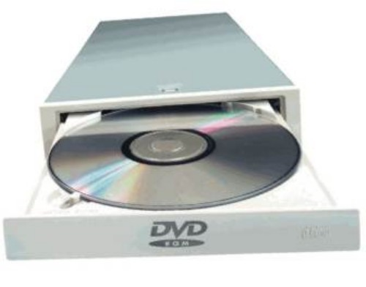
Storage Systems
Storage holds data, instructions, and information for future use
Consists of two parts
Storage Device
Storage Media

Slide 3
Storage Systems
Storage is nonvolatile where as RAM memory is volatile
Two operations associated with storage
Reading - Process of transferring items from storage media to memory
Writing - Process of transferring items from memory to storage media

Slide 4
Storage Capacity
Capacity refers to the number of bytes (characters) a storage media can hold.
Kilobyte (KB)
1 thousand
Megabyte (MB)
1 million
Gigabyte (GB)
1 billion
Terabyte (TB)
1 trillion
Petabyte (PB)
1 quadrillion
Exabyte (EB)
1 quintillion
Zettabyte (ZB)
1 sextillion
Yottabyte (YB)
1 septillion

Slide 5
Hard Drives
Magnetic hard drives contain one or more round pieces of metal (called hard disks or platters) that are coated with a magnetizable substance.

Slide 6
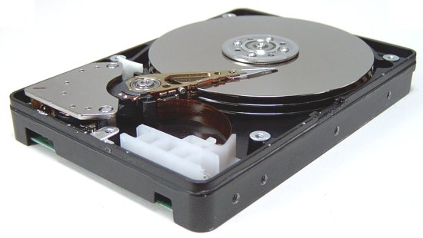
Hard Drives - Parts
Mounting Shaft
Read/Write head
Hard Disks
Access Mechanisms

Slide 7
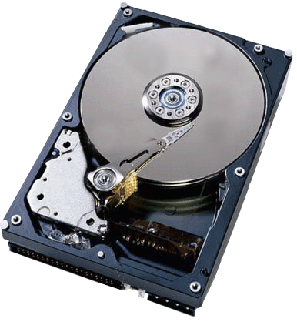
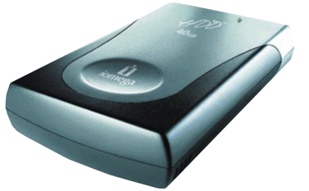
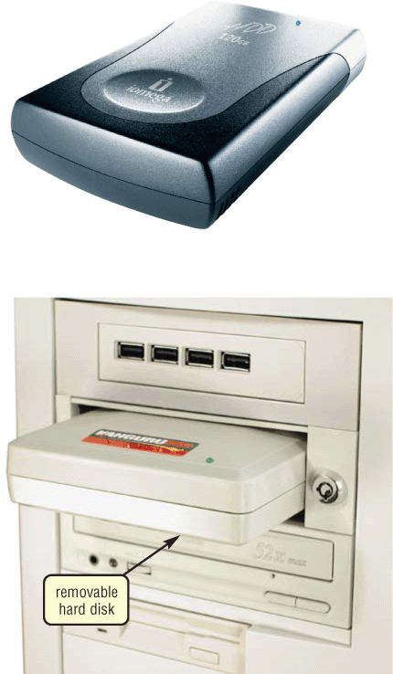
Hard Drives – Three Types
Internal
External
Removable

Slide 8
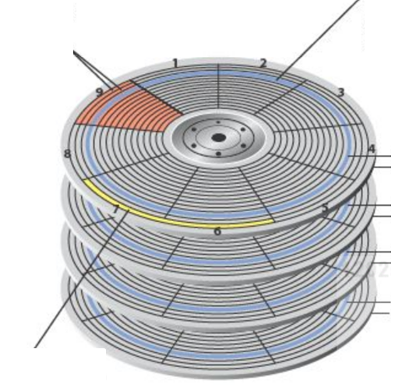
Hard Drives – Organization
Sectors– pie shaped groups of sectors
Tracks – data is stored on circular tracks
Track 13 –Disk 1 top
Track 13 –Disk 1 bottom
Cylinder – a vertical stack of tracks
Track 13 –Disk 2 top
Track 13 –Disk 2 bottom
Track 13 –Disk 3 top
Track 13 –Disk 3 bottom
Track 13 –Disk 4 top
Track 13 –Disk 4 bottom
Clusters– one or more sectors form clusters, the smallest storage area on a disk.

Slide 9
Hard Drives – Access Time
The total time that it takes for a hard drive to read or write data is called the disk access time and requires the following:
Seek time - The read/write heads move to the cylinder that contains (or will contain) the desired data.
Rotational delay - The hard disks rotate into the proper position so that the read/write heads are located over the part of the cylinder to be used.
Data movement time - Reading the data from the hard disk to memory, or transfers from memory and is stored on the hard disk.

Slide 10
Hard Drives – Disk Cache
A disk cache holds data that has recently been read from the hard drive.
If that data is needed soon in memory it is retrieve from the cache rather then from the hard drive when they are requested.

Slide 11
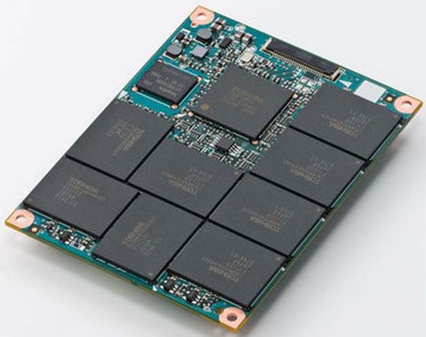
Hard Drives - SSD
Solid state drives use the same type of memory used in USB drives.
Much faster in accessing information over the standard hard drive
More stable then hard drives

Slide 12
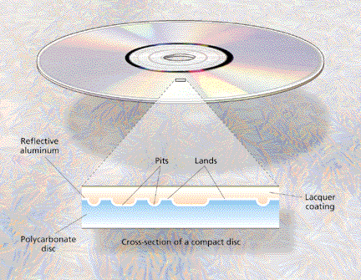
Optical Discs
Flat, round, portable metal discs made of metal, plastic, and lacquer

Slide 13
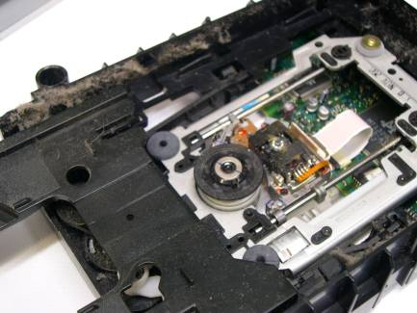
Optical Discs

Slide 14
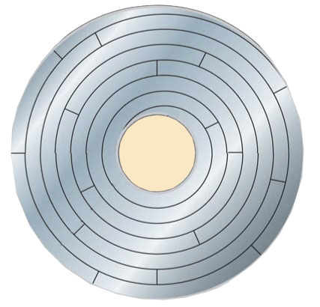
Data Storage on a CD/DVD
single track spirals to edge of disc
disc sectors

Slide 15
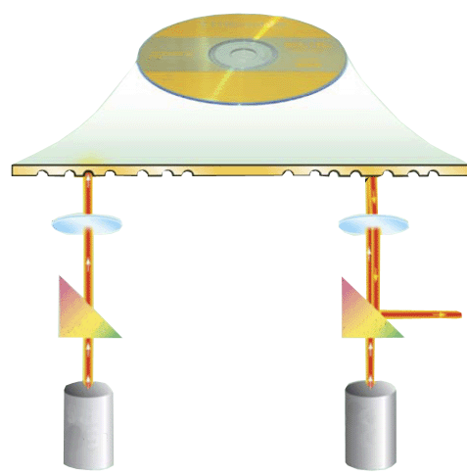
Parts of a Optical Discs Player
disc label

Slide 16
Parts of a Optical Discs Player
disc label
laser diode

Slide 17
Parts of a Optical Discs Player
disc label
prism
laser diode

Slide 18
Parts of a Optical Discs Player
disc label
lens
prism
laser diode

Slide 19
Parts of a Optical Discs Player
disc label
lens
prism
light- sensing diode
laser diode

Slide 20
Parts of a Optical Discs Player
disc label
pit
lens
prism
light- sensing diode
laser diode

Slide 21
Parts of a Optical Discs Player
disc label
pit
land
lens
prism
light- sensing diode
laser diode

Slide 22
Reading Data
Step 1. Laser diode shines a light beam toward disc
disc label
pit
land
lens
prism
light- sensing diode
laser diode

Slide 23
Reading Data
Step 2. The light passes through the prism and is focused by lens on to the metal layer of the disc.
disc label
pit
land
lens
prism
light- sensing diode
laser diode

Slide 24
Reading Data
Step 3. If light strikes a land, it is reflected off the prism into the light sensing diode.
disc label
pit
land
lens
1
This represents a 1 in binary
prism
light- sensing diode
laser diode

Slide 25
Reading Data
Step 4. If light strikes a pit, it is scattered and no light reaches the light sensing diode
disc label
pit
land
lens
0
1
This represents a 0 in binary
prism
light- sensing diode
laser diode

Slide 26
Flash Memory
Flash memory is a chip-based storage medium that represents data using electrons.

Slide 27
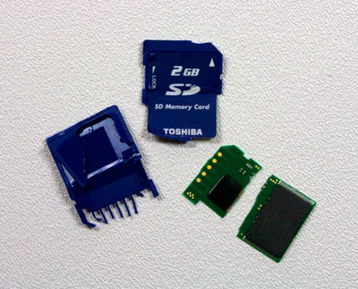
Flash Memory – Memory Cards
One of the most common types of flash memory media is the flash memory card—
a small card containing
flash memory chips
controller chip
other electrical components
metal contacts

Slide 28
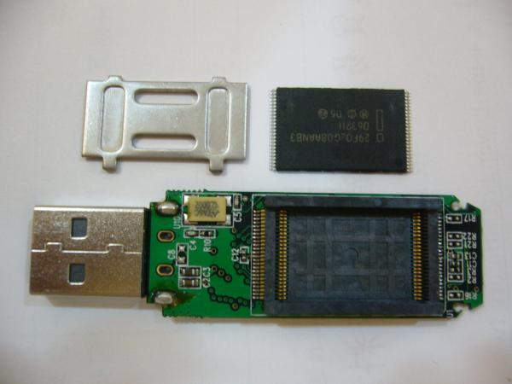
Flash Memory - USB
USB flash drives consist of flash memory media integrated into a self-contained unit that contains;
flash memory chips
controller chip
other electrical components
metal contacts
connects to a computer or other device via a standard USB port and is powered via the USB port.

Slide 29
Network Storage and Online/Cloud Storage Systems
Remote storage - A storage device that is accessed through a local network or through the Internet.
Cloud storage - Remote storage accessed via the Internet

Slide 30
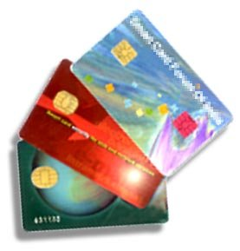
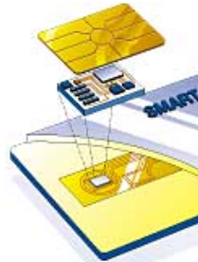
Smart Cards
A smart card is a credit card–sized piece of plastic that contains computer circuitry containing
a processor
memory
storage.
Used in secure access system.

